Slide 1

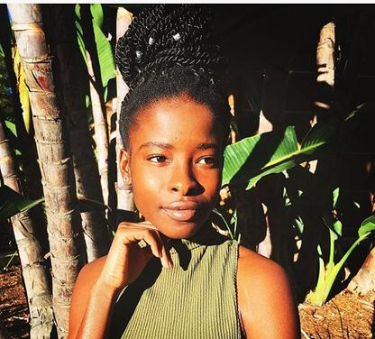
AMANDA Gorman
--- a famous female poet

Slide 2
Background
Born in Los Angeles
Didn’t have a father in childhood
Raised by her single mother, with her two siblings

Slide 3
Disease
speech impediment
Hypersensitive to sound

Slide 4
Disease
NEVER GIVE UP!

Slide 5
Personalities
Tough ( a speech impediment) (an auditory processing disorder)
Ambitious ( was inspired by Nobel Prize laureate Malala Yousafzai)
selfless ( a non-profit organization which helps youth develop writing skills and leadership)

Slide 6
A diligent student
“While other students were on the jungle gym, I was writing in my journal on a park bench, or trying to write my own dictionary”, She said.
reading lots of books
Study hard in school
obsessed with writing
Passionate about the closing to the truth

Slide 7
A Youth Poet
A dream for
life, liberty, and happiness.

Slide 8
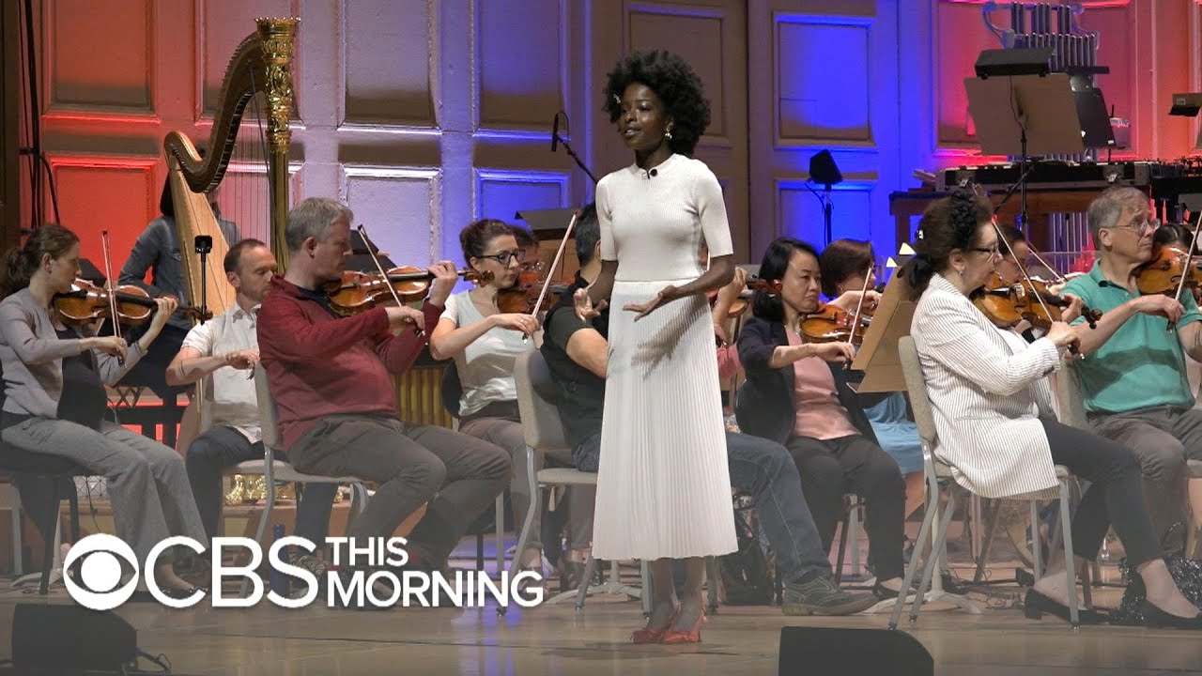
Fourth Of July Poem

Slide 9

Fourth Of July Poem

Slide 10
A Youth Poet
“While we cannot shake or cast,
Together, we sign it.
Together, we declare it,
and share it”.

Slide 11
References
Khaliha, H(2018, June 4^{th).}America's First Youth Poet Laureate Amanda Gorman on the Power of Young Women, College Women of the Year.Retrieved from https://www.glamour.com/story/americas-first-youth-poet-laureate-amanda-gorman-on-the-power-of-young-women
Adeel,H.(2018,Feb 28th). A Yong Poet’s Inspiration, The New York Times. Retrieved
from https://www.nytimes.com/2018/02/28/us/a-young-poets-inspiration.html
Matt, P.(2017, Sep 17th). Watch the first-ever U.S. youth poet laureate perform a stunning poem about social change, Mashable. Retrieved from
https://mashable.com/2017/09/17/amanda-gorman-us-youth-poet-laureate-social-good/
Elena,S(2018,May 29th).America's 20-year-old youth poet laureate won't let small-minded prejudice' stop her, Yahoo lifestyle. Retrieved from https://www.yahoo.com/lifestyle/americas-20-year-old-youth-poet-laureate-wont-let-small-minded-prejudice-stop-215752247.html

